Slide 1

The ICES approach to data-limited stocks
Anne M. Cooper
ICES Secretariat

Slide 2
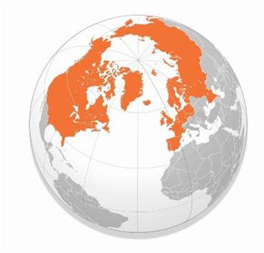
International Council for the Exploration of the Sea
International Council for the Exploration of the Sea
Global organization for enhanced ocean sustainability.
4000 scientists from 300 institutes
Established in 1902 to:
- Coordinate & promote marine science
- Collect & maintain marine data for shared use
Provide science-based advice on marine issues
Goal: to ensure that best available science and information is available to inform decision-making on sustainable use.
Notes:
ICES is a global organization for enhanced ocean sustainability relying on a bottom-up network of over 4000 sciences from about 300 marine research institutes around the world.
It was established over 100 years ago with the same pillars that it has today: to coordinate and promote marine research, collect and maintain marine data for shared use, and to provide science-based advice on marine issues.
These pillars support the goal to ensure the best available science and information is available to inform decision-making on sustainable use of marine resources.
This is key to understanding ICES motivation for progressing data-limited stock assessment methods.

Slide 3
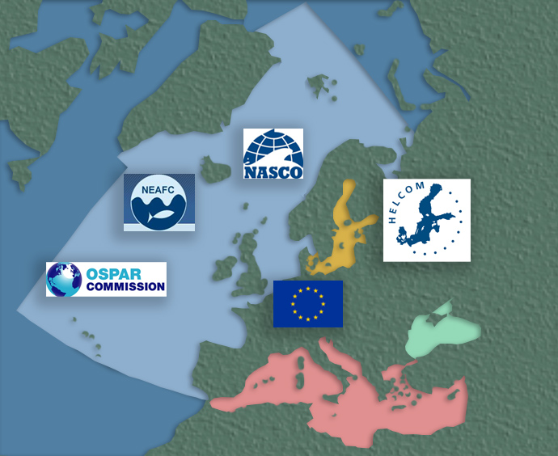
The motivation
Precautionary approach
MSY framework
Science-based
Data-driven
Consensus built
Advice upon request

Slide 4
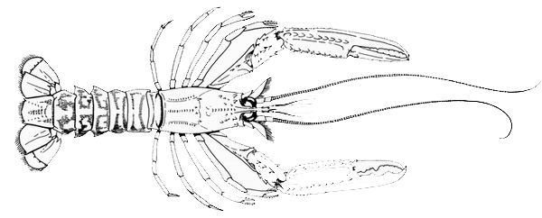
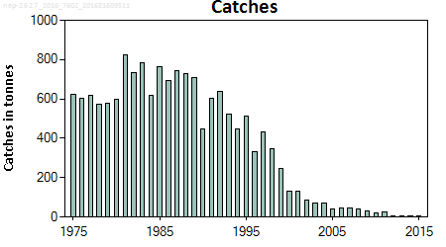
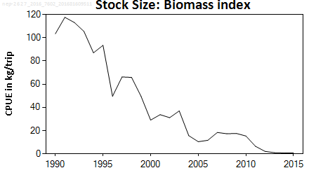
The motivation
Contracted to advise on sustainable exploitation for >260 stocks.
65% without analytical assessments.
- Including high-value fisheries

Slide 5
Underlying principles
Available information should be used
The advice should be based on the same principles as applied for stocks with analytical assessments and catch forecasts
A precautionary approach should be followed
As information becomes increasingly limited more conservative reference points should be used and a further margin of precaution should be adopted when the stock status is poorly known

Slide 6




Underlying principles

Slide 7
ICES DLS framework

Slide 8
ICES stock categories
1 | Data rich stocks with an accepted analytical assessment and forecast for MSY
2 | Data rich stocks with an analytical assessment and forecast accepted for trends only
3 | Surveys indicating biomass/abundance trends
4 | Reliable time-series of catch data to approximate MSY
5 | Only catch or landings available
6 | Only landings available and largely discarded
Several available methods per category, based on stock status. Tools to facilitate the precautionary approach.

Slide 9
Precautionary tools
Extremely low biomass
Objective
To maintain existing resources
Method*
Advise zero catch
* Available method in every data category
http://ec.europa.eu/environment/marine/eu-coast-and-marine-policy/index_en.htm

Slide 10
Precautionary tools
Uncertainty Cap + 20%
Objective
To address uncertainty or noise in the data and its influence on the catch advice
Method
Limit the amount of change to + 20% in the recent catch or trend projection
http://ec.europa.eu/environment/marine/eu-coast-and-marine-policy/index_en.htm

Slide 11
Precautionary tools
Precautionary buffer -20%
Objective
To move in the direction of sustainable exploitation
Method
Apply a -20% to the catch advice when:
Stock status relative to reference points is unknown,
Exploitation unknown.
Can avoid the buffer if expert
judgment finds there is:
no reproductive
impairment,
Low F in target fishery,
substantial increase in
abundance
http://ec.europa.eu/environment/marine/eu-coast-and-marine-policy/index_en.htm

Slide 12
“Surveys”
“Catch” only
Bycatch
Trends only
Catch over time
65% without analytical assessments

Slide 13
Category 6 methods
Data / Info available
Stock status
Stock status
PA Buffer
Bycatch stocks
Largely discarded at sea
Sharks, skates, gurnards

Slide 14

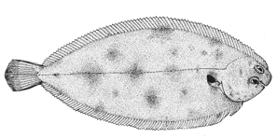
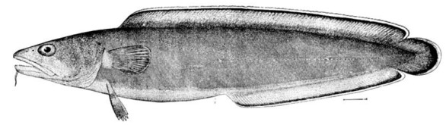
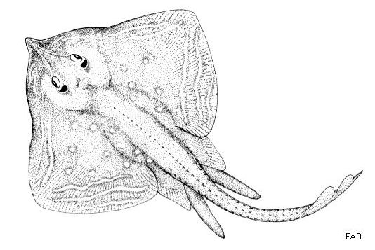


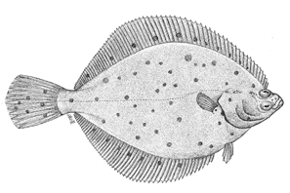


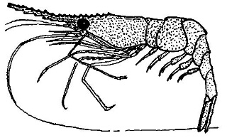

Method 6.2

Slide 15
Category 5 methods
Data / Info available
Stock status
Stock status
PA Buffer
Catch/landings only methods
No consideration of life-history

Slide 16
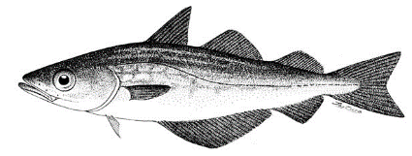
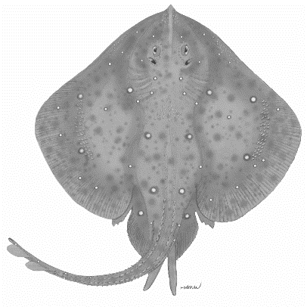
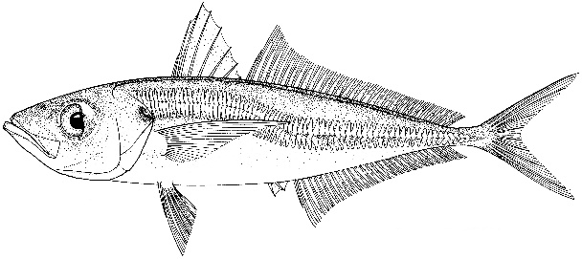
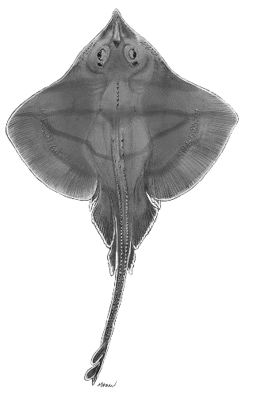

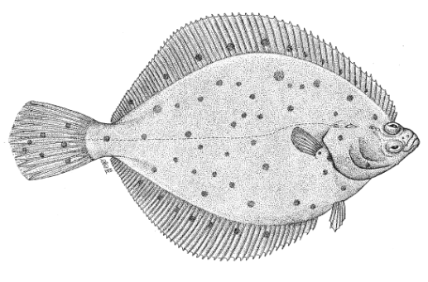
Method 5.2

Slide 17
Category 4 methods
Stock status
Data / Info available
Cap
Stock status
PA Buffer
Rarely used tools
DCAC
DB-SRA
Data-borrowing for sedentary species

Slide 18
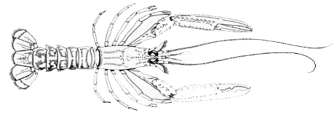
Method 4.14 “data borrowing”
F < F_{MSY} estimates from similar neighbouring areas and no indication of declining catch rates, then the stock is likely to be above MSY B_{trigger}.
The advised landings should be no greater than the medium-term (~ten year) average landings.
F > F_{MSY} estimates from similar neighbouring areas
Apply a 20% Precautionary Buffer to the medium term (~ten year) average landings.
Change in fishing or life-history characteristics in the medium- term history?
Apply 20% Precautionary Buffer to the short-term (~three year) average landings should be advised.

Slide 19
Category 3 methods
Data / Info available
Stock status
Cap
Stock status
PA Buffer
The precautionary buffer only applies to situations where F is too high or unknown.

Slide 20
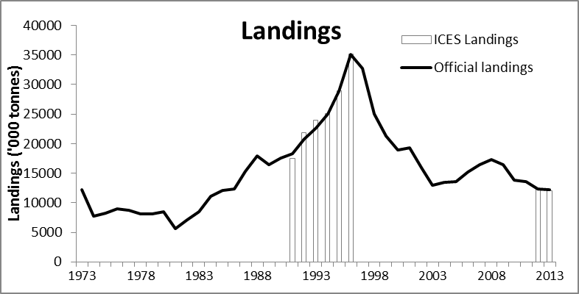
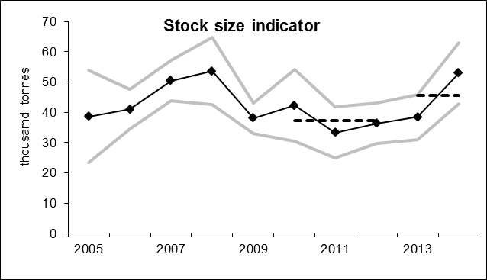

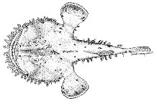
Method Survey-adjusted status quo catch (3.2)
Use the survey trend to adjust the catch.
Limit the survey’s noise with the uncertainty cap, +20%.
Apply the precautionary buffer to the catch advice.

Slide 21
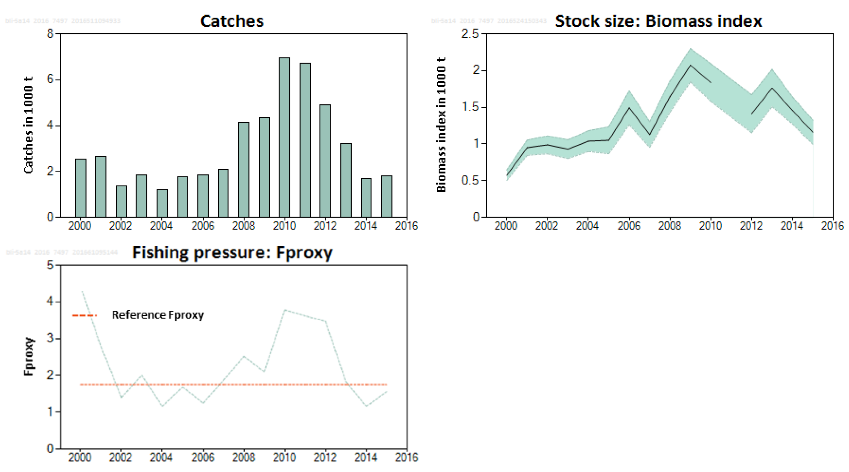
Method F_{proxy} (3.3)
Reference F_{proxy} = catch /survey biomass for the reference period
= equivalent to harvest rate
Reference period = F was okay by expert judgement
I_{y-1} = last survey index; biomass indicator
Method
1 ) F_{proxy} * I_{y-1}
2 ) Apply the 20% Uncertainty Cap
3 ) Apply Precautionary Buffer*
Notes:
The ICES advice has been based on an Fproxy (total catch/survey biomass) target that is the average over the years 2002–2007 where no detrimental effect is observed in the stock dynamics.

Slide 22
How robust is the ICES approach?
ICES should provide more cautious advice as less data are available.
Category 1 and category 6 stocks should be held to the same precautionary standard.
ICES advice should provide for the sustainable exploitation of all stocks via a quantified catch advice
As information becomes increasingly limited more conservative reference points should be used and a further margin of precaution should be adopted when the stock status is poorly known

Slide 23
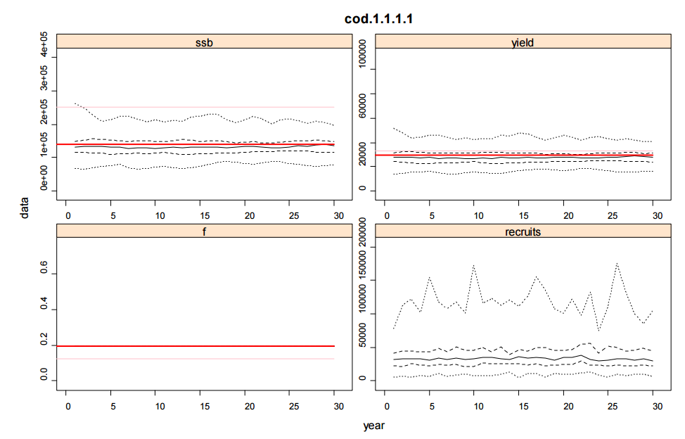
Robustness testing
Use a real category 1 stock
Strip away data to get:
Category 2
Category 3
Category 4
Apply most common method in each category
Compare status over time under different scenarios
Well managed
Well managed to over-exploited
Over-exploited
Over-exploited to well managed
Do we get more conservative catch advice if less data are available?
Notes:
The approach was to start with a data-rich stock in Category 1, then to systematically strip away data from this stock to demote it to lower categories, and applying the most commonly used method that category,
The simulations were designed to investigate: based on the same conditions (stock, fishery, etc.), do we get more conservative catch advice if less data are available?
The objective of the simulations was to provide a direct comparison of the catch advice that each of the DLS categories would deliver given the same underlying stock conditions (the only difference being the amount of information that the given DLS category had access to from the stock), therefore, no feedback was included AND a comparison of the DLS categories was made based on four exploitation scenarios: well-managed, well-managed to overexploited, overexploited, and overexploited to well-managed.
Projections of SSB, F, yield (landings) and recruits for the given stock scenario
dark red line corresponds to FMSY, light red lines to F0.1
In all cases the solid black line is the median, the hashed lines at the 25th and 75th quantiles, and the dotted lines the minimum and maximum
Remaining plots compare catch advice across DLS categories (e.g. TACx_y is catch advice for Category x divided by that for Category y) for a constant survey catchability (middle set) and a trend in survey catchability (bottom-set), with red lines indicating a TACx_y ratio of 1.

Slide 24
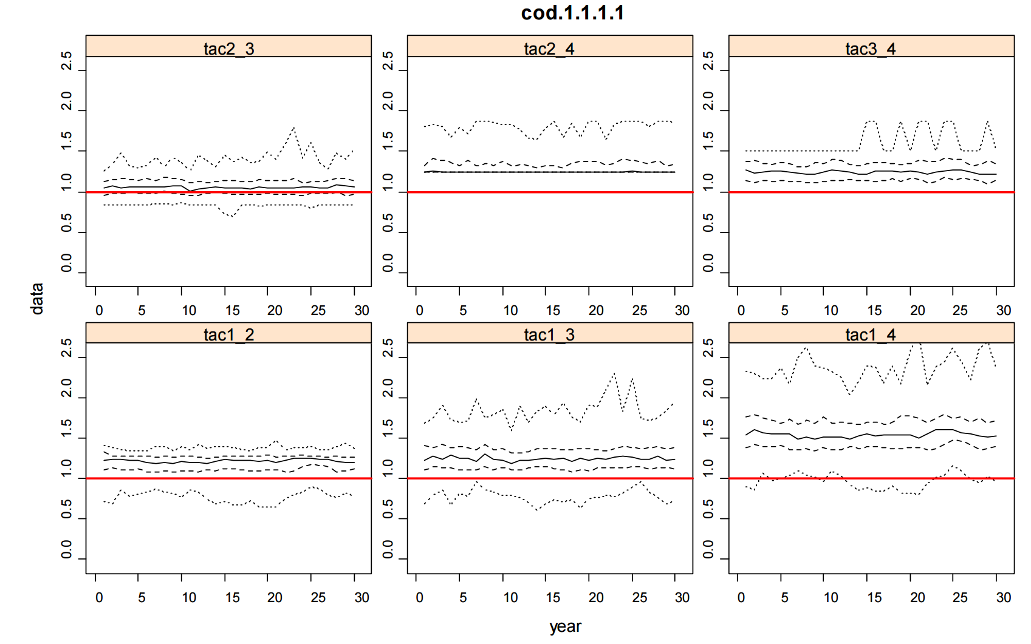
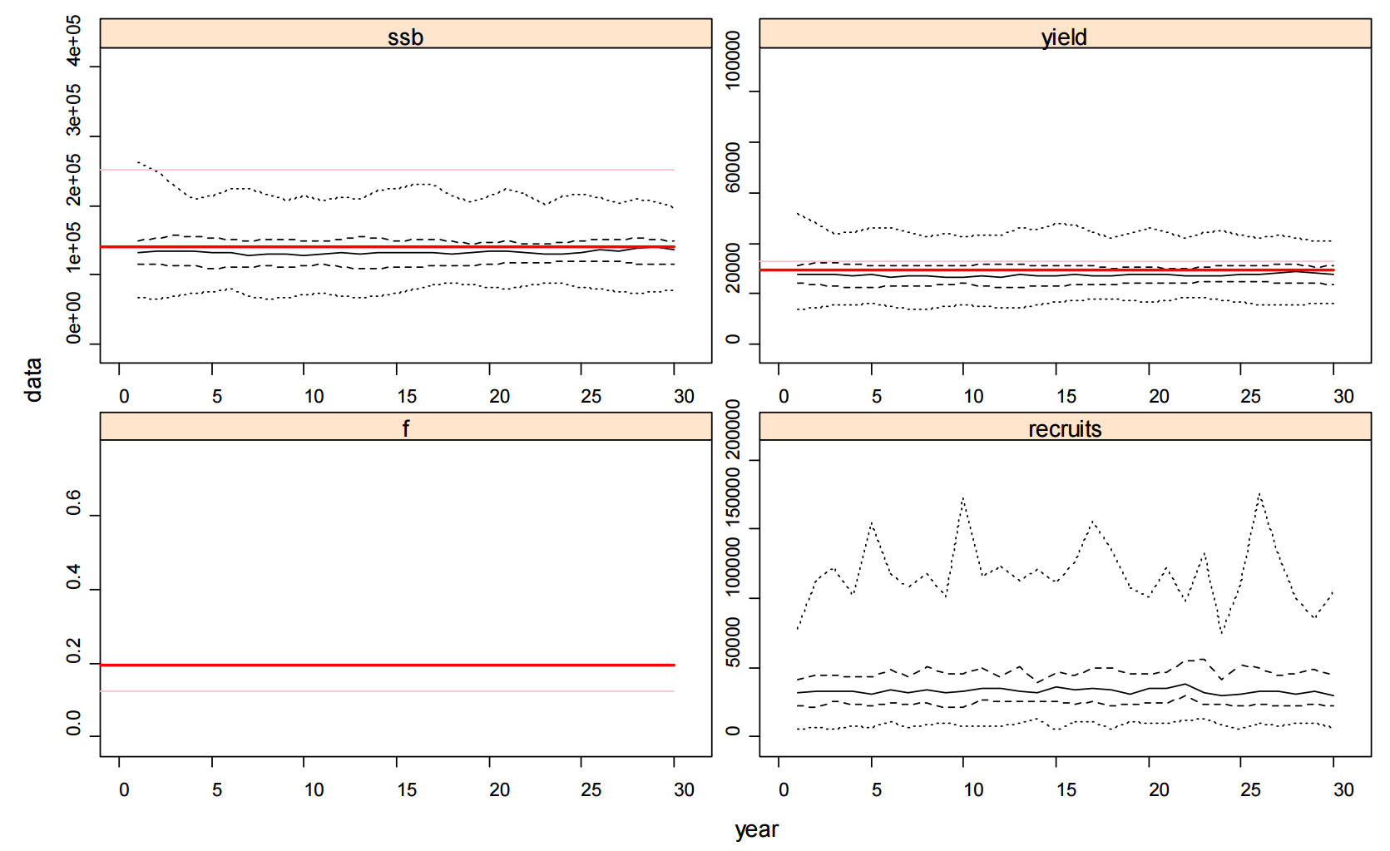
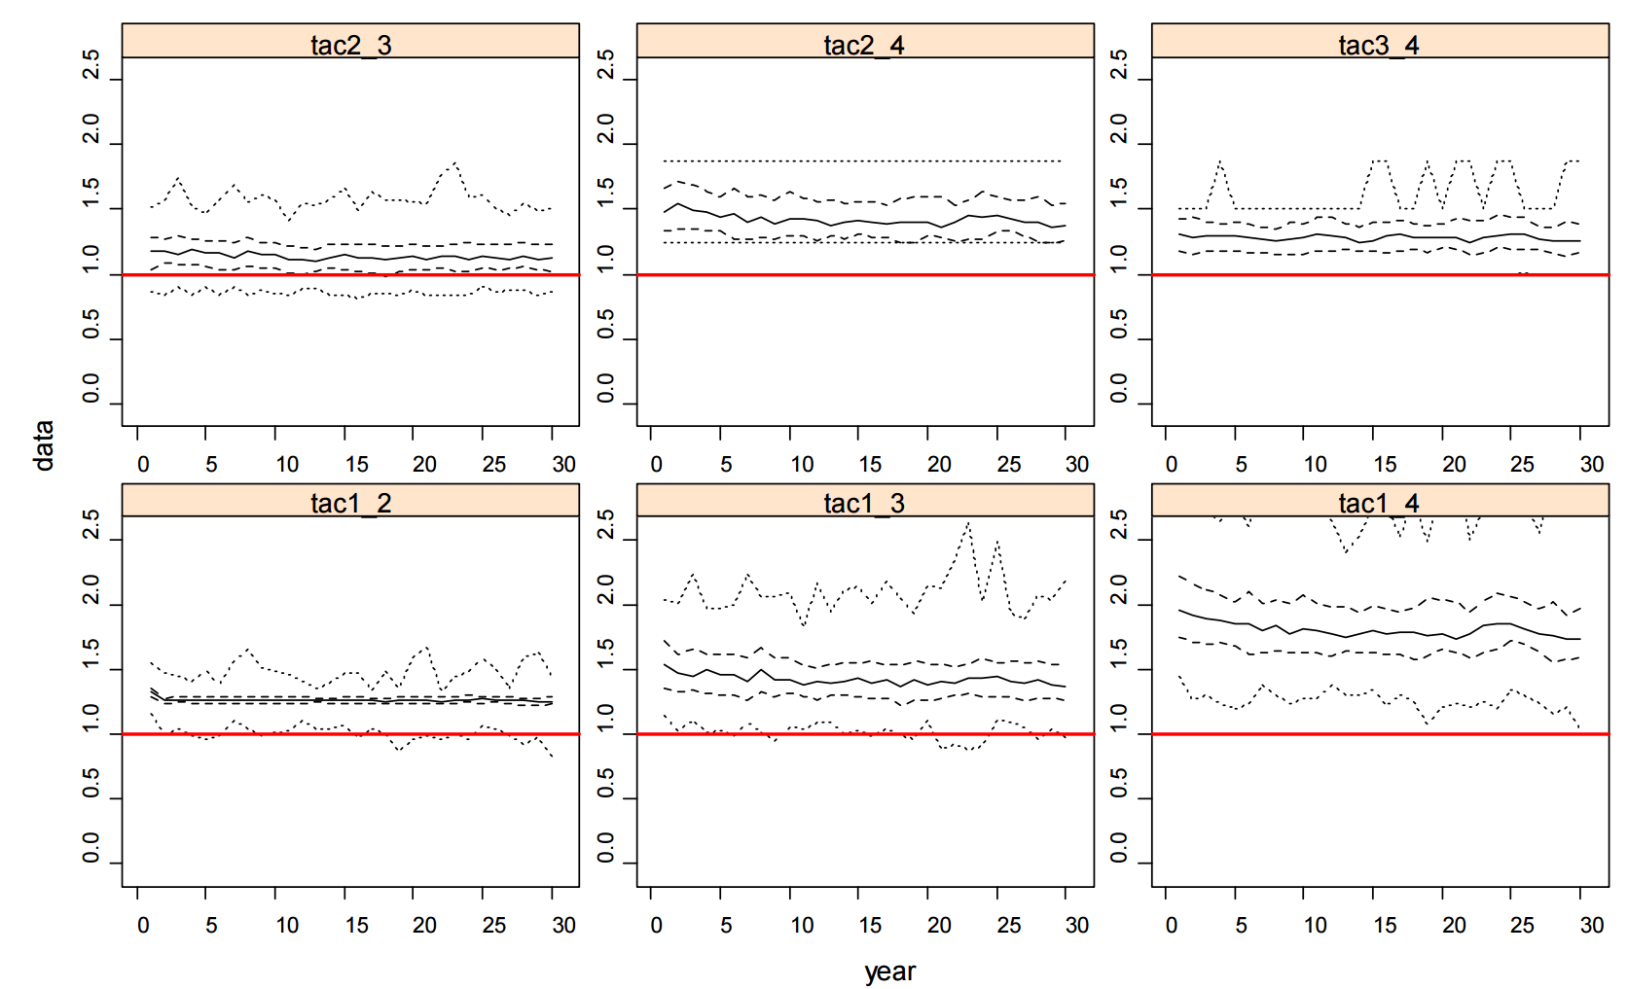
Well-managed scenario
More conservative catch advice when there are less data available
Notes:
Results always show the catch advice from a category that uses more data divided by that from a lower category, so the expectation is that the distribution of this ratio (derived from 100 simulations) should be above 1 in each case (i.e. positive performance is when the DLS framework provides more conservative catch advice when there are less data available).
Performance improves in the presence of a positive trend in survey catchability, a feature that is repeated for all stock scenarios.
This implies that the lower categories introduce greater precaution when there is a trend in survey catchability that is not accounted for by the HCR, likely due to the additional constraints that the lower categories impose (i.e. change limit and pre-cautionary buffer).

Slide 25
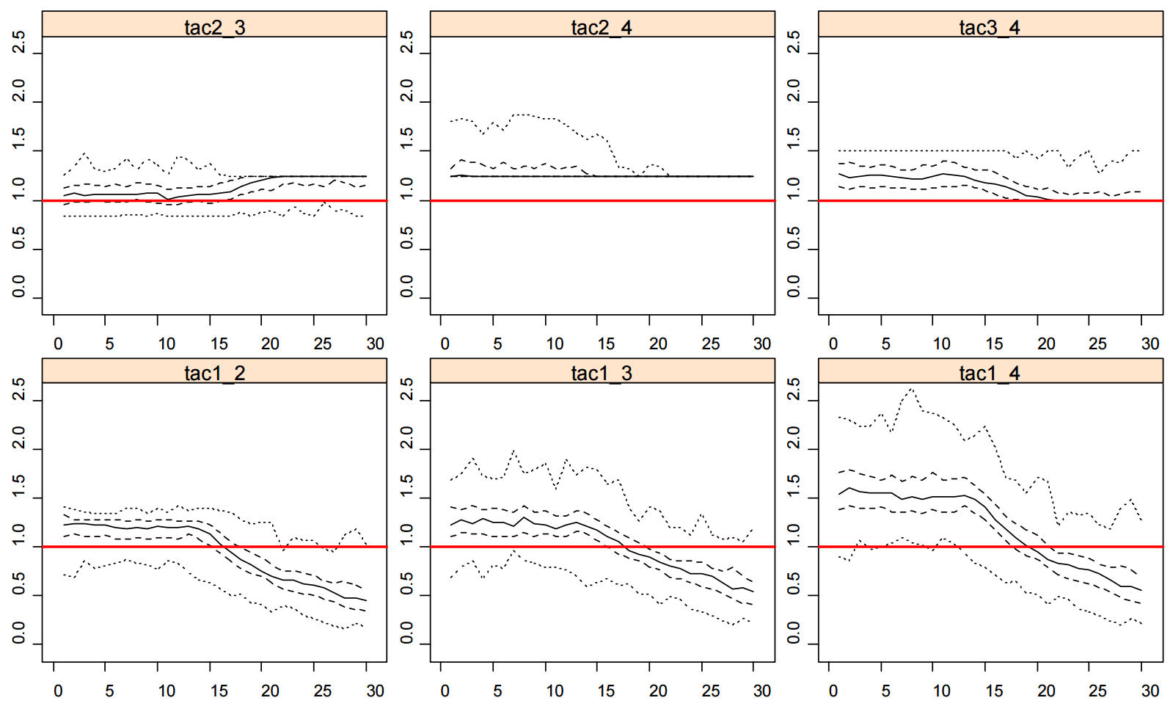
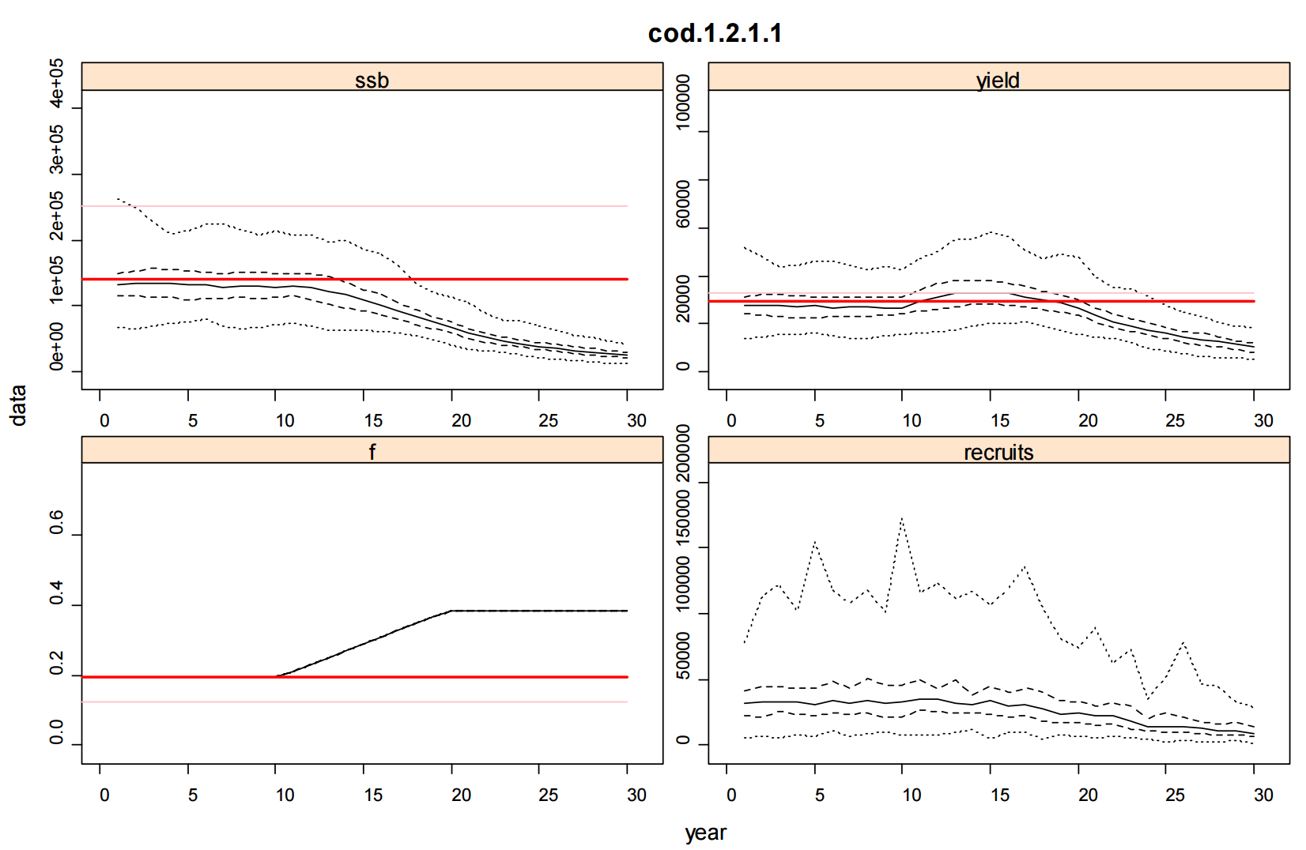
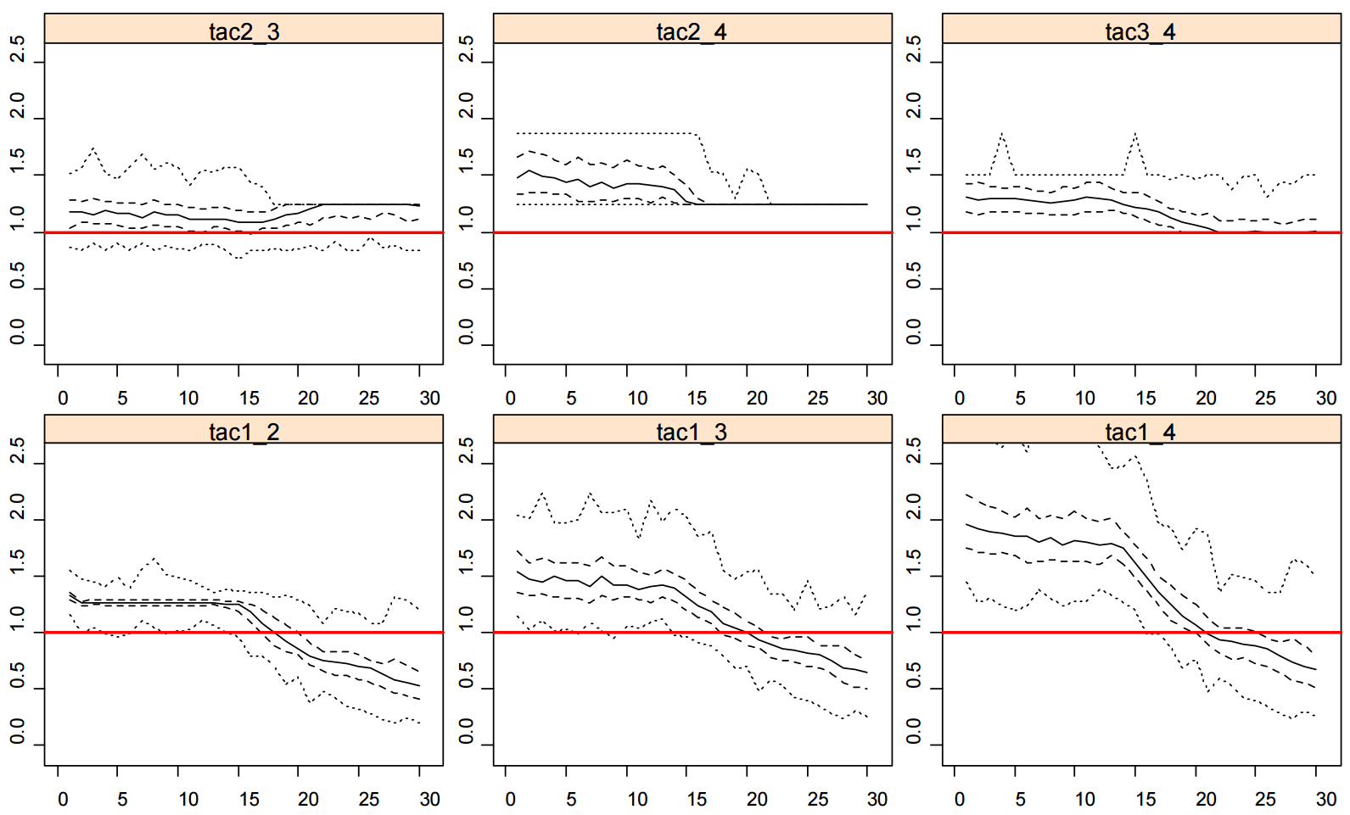
Well-managed to over-exploited scenario
Performance deteriorates
Notes:
Results always show the catch advice from a category that uses more data divided by that from a lower category, so the expectation is that the distribution of this ratio (derived from 100 simulations) should be above 1 in each case (i.e. positive performance is when the DLS framework provides more conservative catch advice when there are less data available).

Slide 26
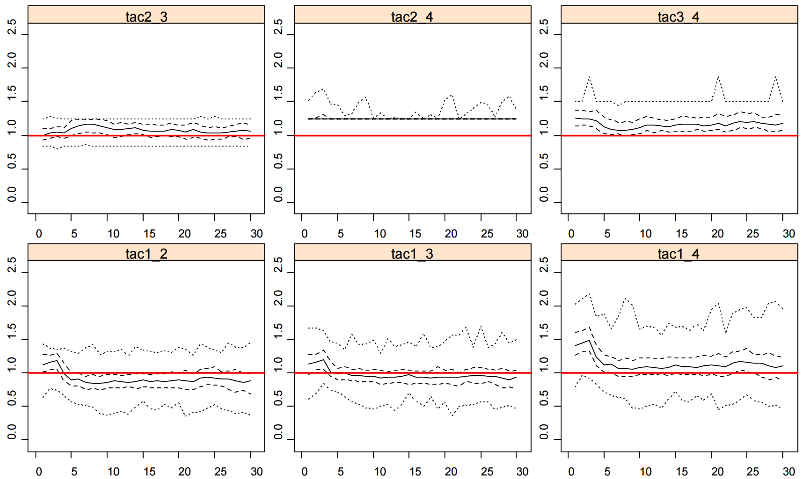
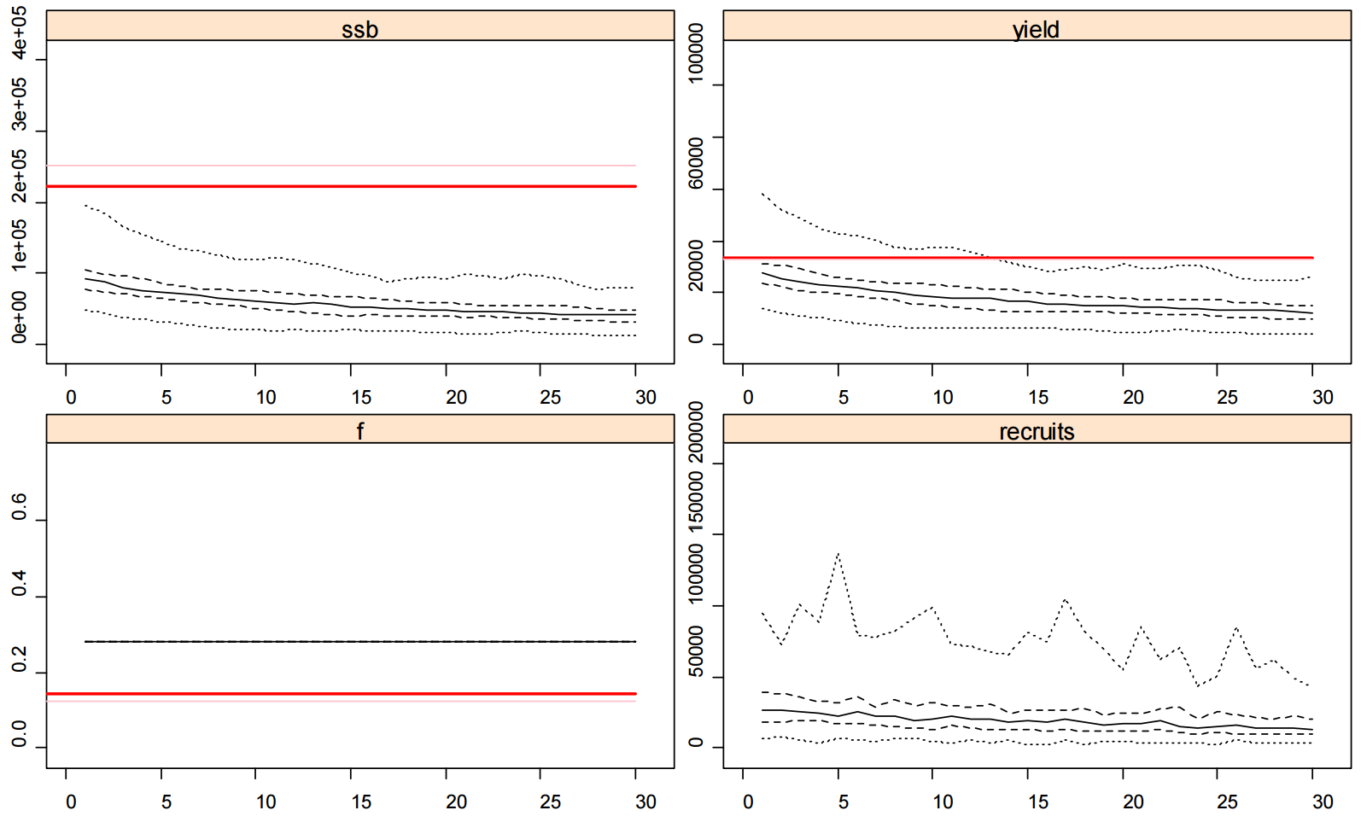
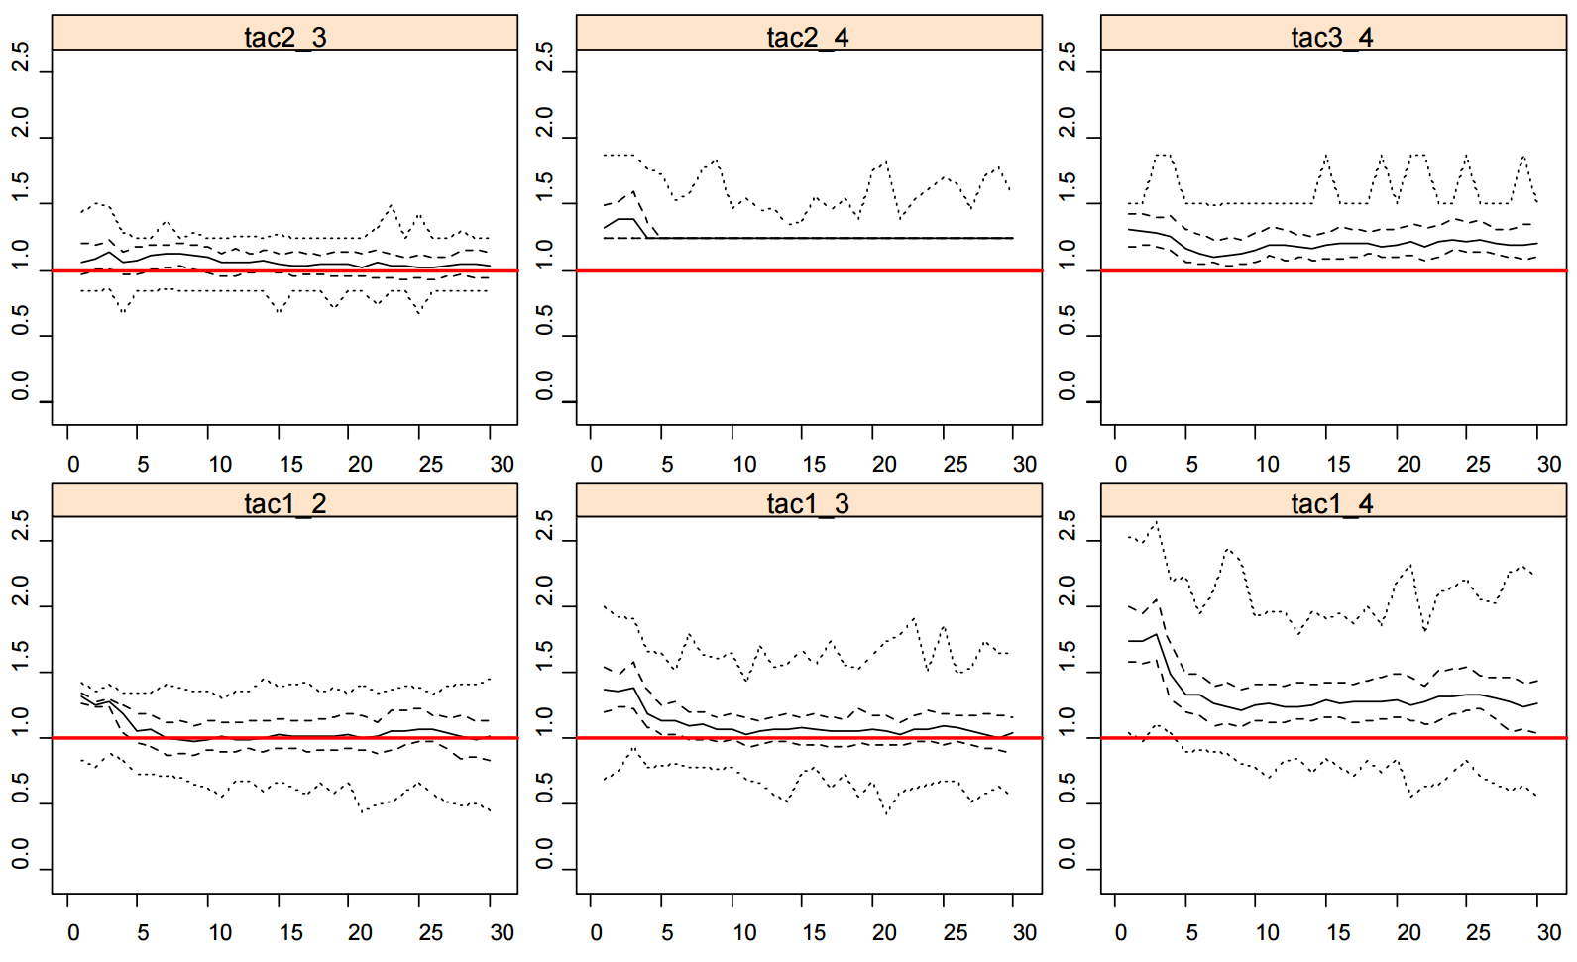
Over-exploited scenario
Performance deteriorates
Notes:
Results always show the catch advice from a category that uses more data divided by that from a lower category, so the expectation is that the distribution of this ratio (derived from 100 simulations) should be above 1 in each case (i.e. positive performance is when the DLS framework provides more conservative catch advice when there are less data available).

Slide 27
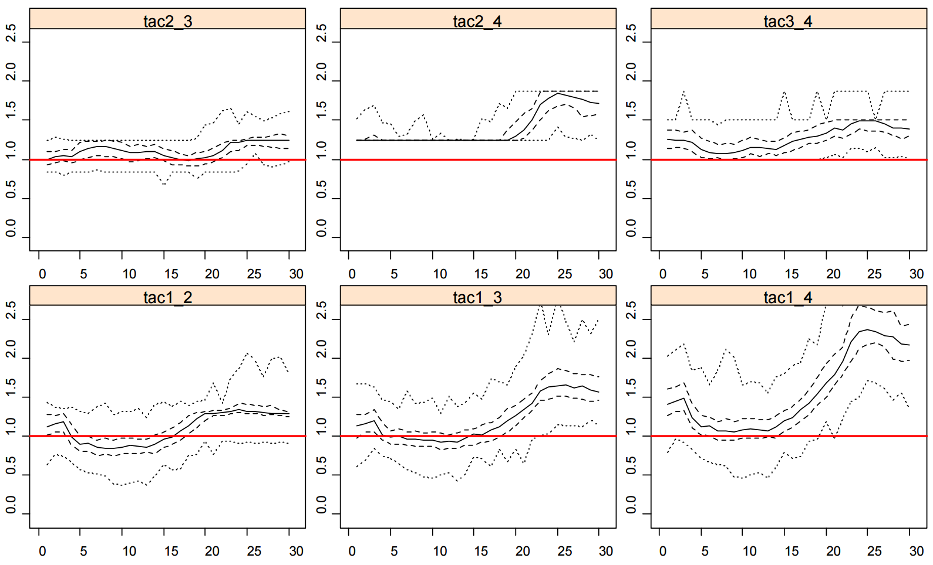
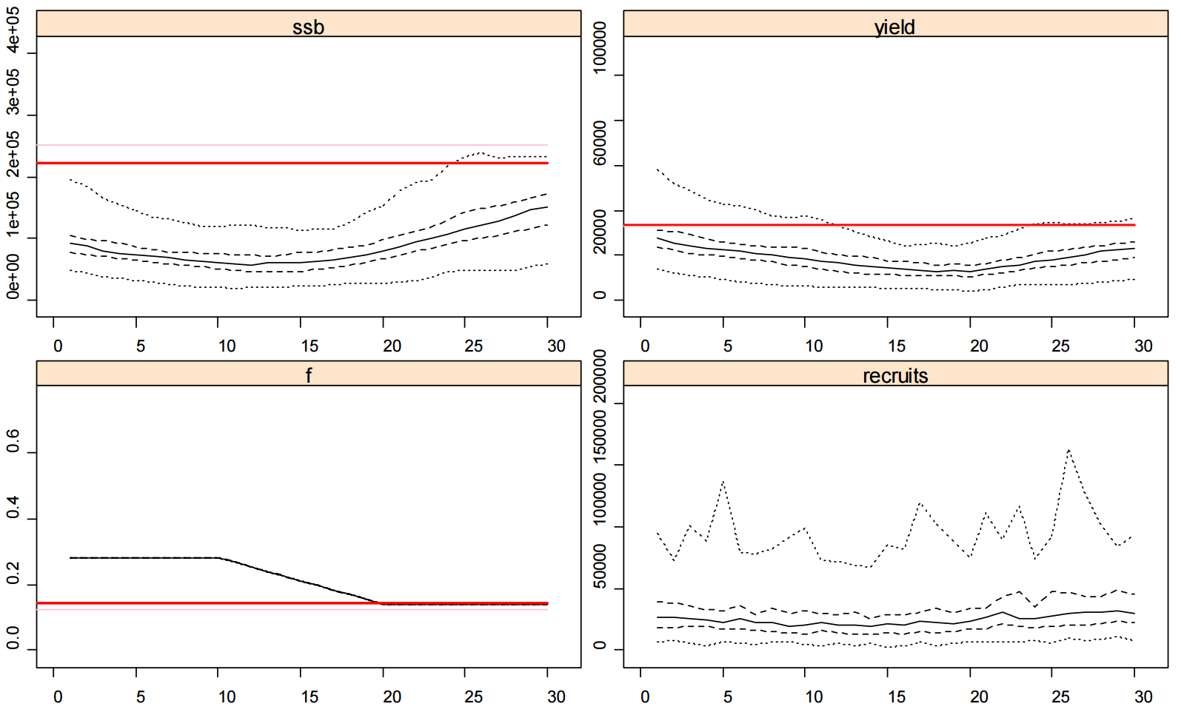
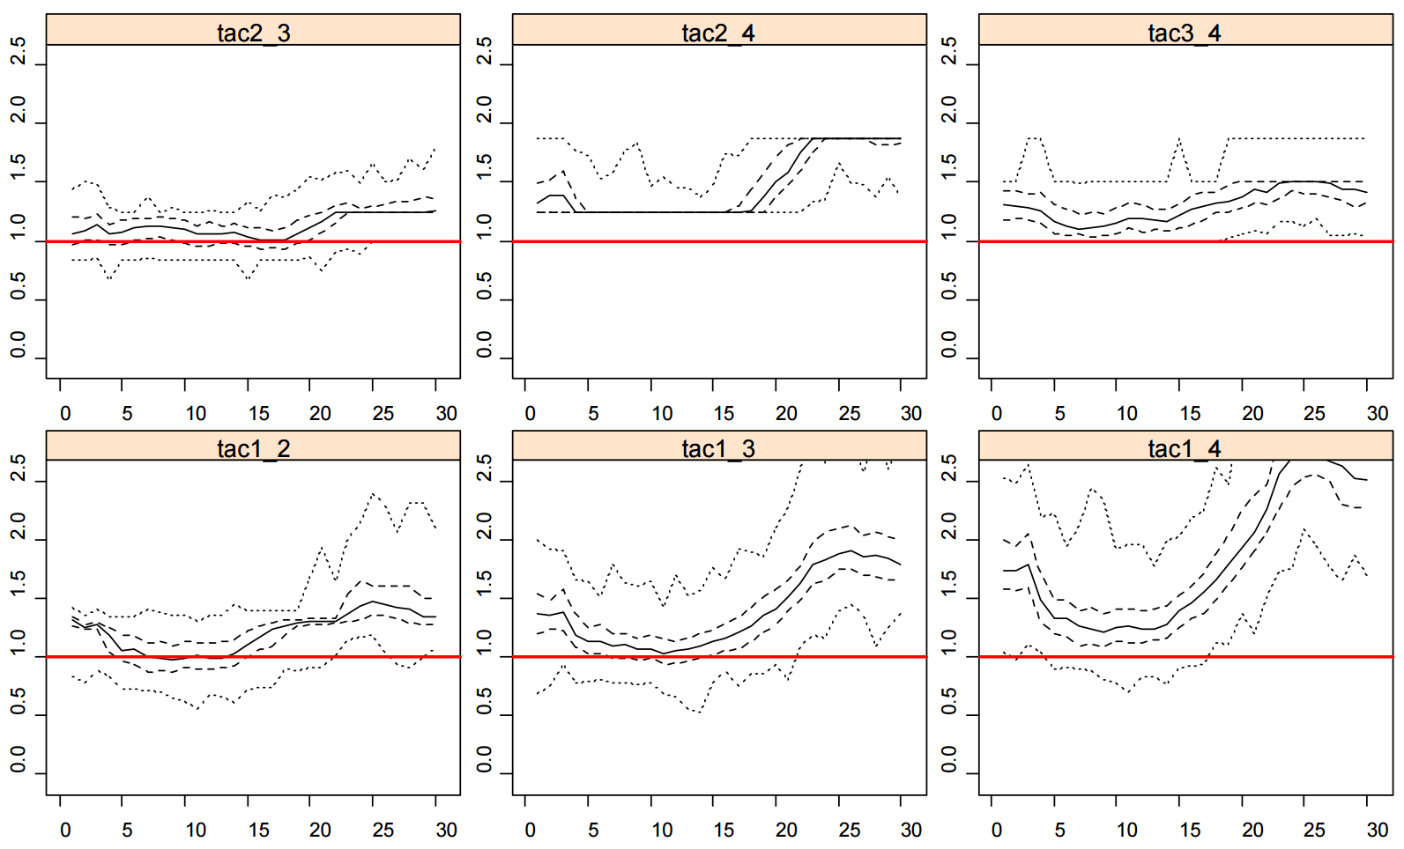
Over-exploited to well-managed scenario
Mixed performance
Notes:
Results always show the catch advice from a category that uses more data divided by that from a lower category, so the expectation is that the distribution of this ratio (derived from 100 simulations) should be above 1 in each case (i.e. positive performance is when the DLS framework provides more conservative catch advice when there are less data available).

Slide 28
Robustness testing - conclusions
Well-managed scenario
- More conservative catch advice when
there are less data available.
Well-managed to overexploited scenario
- Performance deteriorates due to
20% uncertainty cap
Lack of target
Overexploited scenario
- Less conservative catch advice when less data available.
Targets needed!
- Overexploited stocks could be driven to a very low level.

Slide 29
Targets : the 1st step
Develop methods for proxy reference points
Category 3 and 4; stock status relative to reference points unknown
Available data types vary among stocks
Methods applied by stock experts using available data
Stock status relative to proxy used to maintain or reduce catch advice

Slide 30
ICES approach to MSY proxy reference points
Estimate proxies for F_{MSY} and MSY B_{trigger} (based on the data available and expert judgement)
Classify the stocks in relation to the estimated proxies.
F_{MSY} proxy
the exploitation rate that provides maximum long- term yield.
MSY B_{trigger} proxy
the stock size that triggers a cautious response (i.e., advice on a reduced fishing mortality relative to the F_{MSY} proxy to allow the stock to rebuild).
Notes:
The ICES approach to the provision of scientific advice does not use a BMSY estimate but instead, an MSY Btrigger (ICES, 2015a).
BMSY is a notional value around which stock size fluctuates when fishing at FMSY. BMSY strongly depends on the interactions between the fish stock and the environment it lives in, including biological interactions between different species. Historical stock size trends may not be informative about BMSY; e.g. when F has exceeded FMSY for many years or when current ecosystem conditions and spatial stock structure are, or could be, substantially different from those in the past.
MSY Btrigger is considered the lower bound of stock size fluctuation around BMSY. It is a reference point that triggers a cautious response, in the form of reduced fishing mortality, to allow the stock to rebuild. Determination of MSY Btrigger in principle requires contemporary data with fishing at FMSY to identify the normal range of fluctuations in biomass when stocks are fished at this fishing mortality rate.

Slide 31


Stock status
Desirable
Exploited at or below the F_{MSY} proxy and has a stock size equal to or larger than the MSY B_{trigger} proxy
Undesirable
Either exploited above the F_{MSY} proxy or has a stock size smaller than the
MSY B_{trigger} proxy.
Notes:
FMSY proxy corresponds to the exploitation rate that will provide maximum long-term yield.
MSY Btrigger proxy corresponds to the stock size that triggers a cautious response; i.e. advice on a reduced fishing mortality relative to the FMSY proxy to allow the stock to rebuild.
In this context, a stock in a desirable statusis being exploited at or below the FMSY proxy with a stock size equal to or larger than MSY Btrigger proxy.
In turn, stocks are in an undesirable state if they are either exploited above the FMSY proxy or have a stock size smaller than the MSY Btrigger proxy.

Slide 32
Methods based on:
Biomass dynamics models use time series of catch and biomass indices / or assumptions about biomass depletion levels
Output: estimates of exploitation and biomass relative to F_{MSY} and
MSY B_{trigger} proxies
Length-frequencies of catch examine mean length of catch, length at first capture, proportions of immature and large individuals in catch... compare with what would be expected if exploitation was in line with F_{MSY} proxies / or estimate F and compare with F_{MSY} proxies
Output: indication of whether exploitation is consistent with MSY proxies
Age-based per-recruit F proxies
Notes:
Several methods available, each using data in different ways and making different assumptions:
expert knowledge needed to ascertain that the available data are
of sufficient quality and that the methods are appropriate for the stock

Slide 33
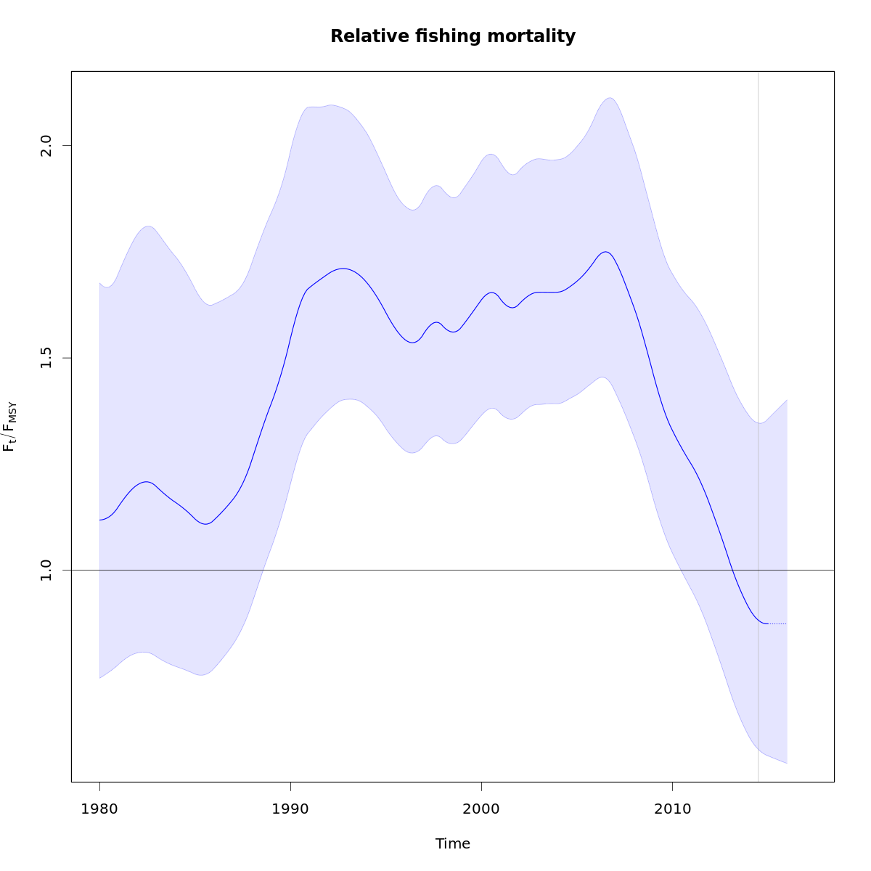
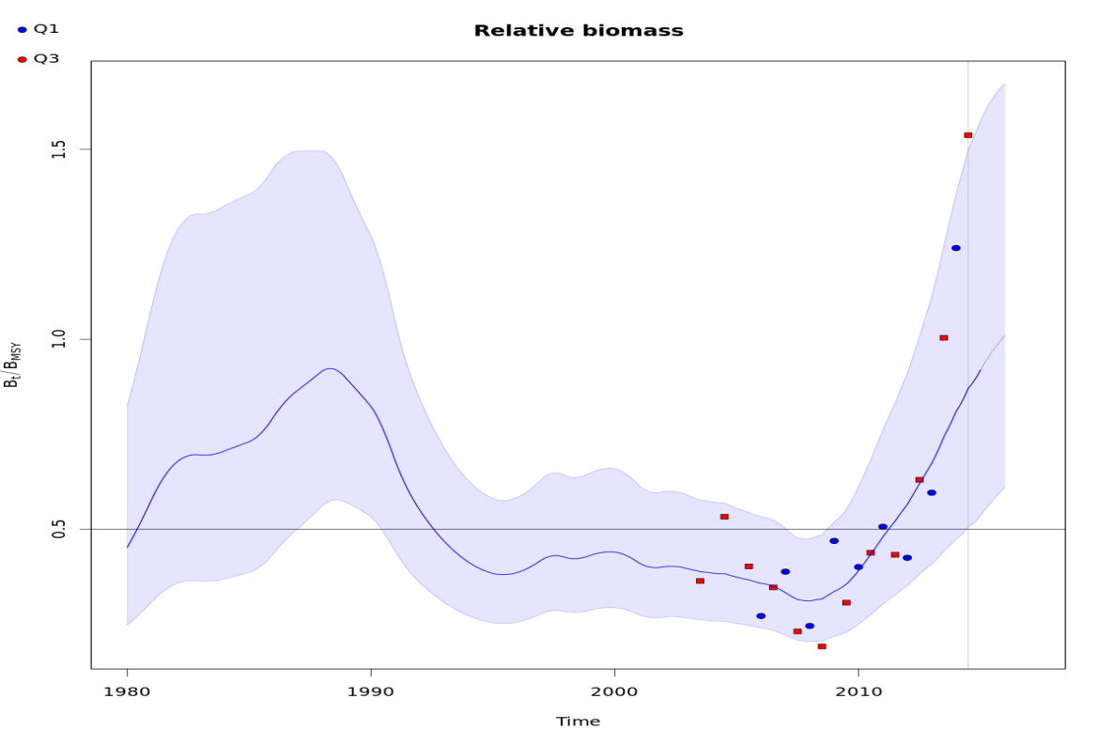

SPiCT
Biomass dynamics model
Data needs: time series of catch and biomass indices
Output:
F_{MSY} estimated internally (model parameter)
MSY B_{trigger} = B_{MSY}/2, where B_{MSY} estimated internally (model parameter)
Estimated time series of F/F_{MSY} and B/MSY B_{trigger}
SPiCT
Notes:
Surplus production model. internally estimate FMSY and BMSY as part of the model fitting.
the BMSY parameter estimated by the model is not considered as a reference point.
ICES set MSY Btrigger at BMSY/2, in parallel with what has been the usual ICES practice when surplus production models are used for Category 1 stocks

Slide 34
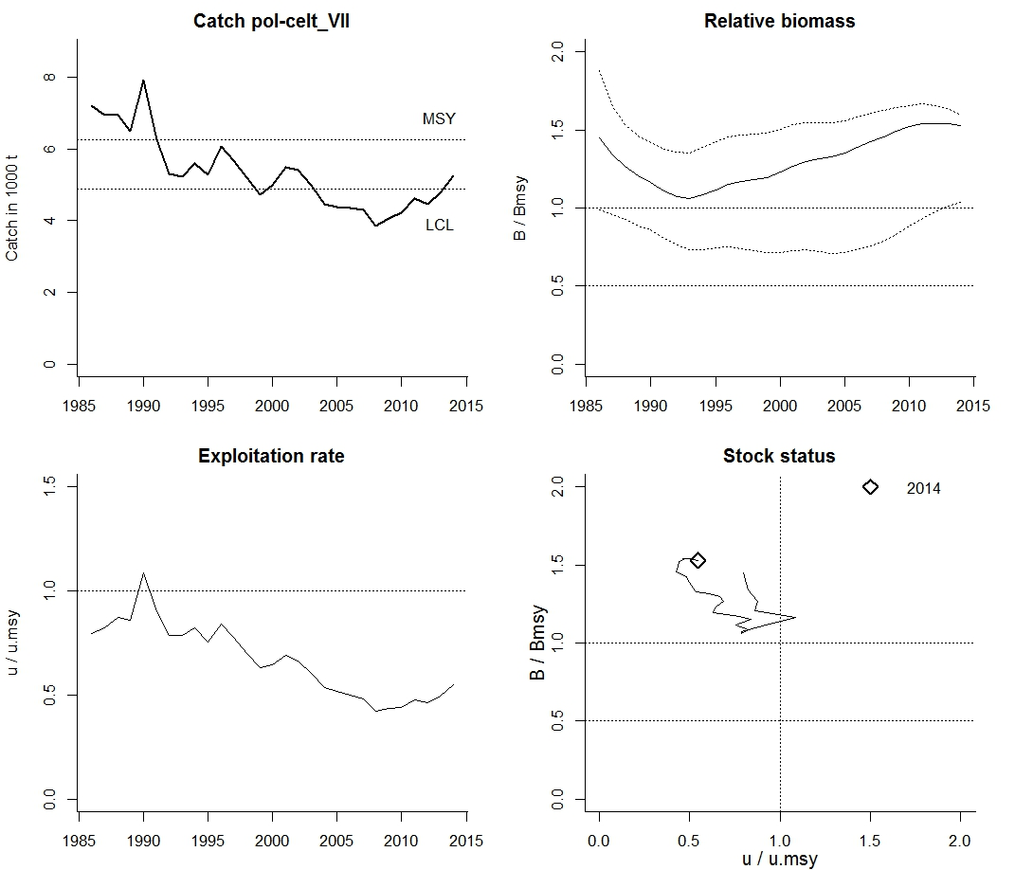
CMSY
Biomass dynamics model, fitted with minimal data
Data needs: time series of catch
Assumptions: need to provide ranges for resilience parameter (r) and
for biomass depletion status (B/B₀) at beginning and end of time series
Output:
Estimated time series of F/F_{MSY} and B/MSY B_{trigger}
CMSY
Notes:
Surplus production model. internally estimate FMSY and BMSY as part of the model fitting.
the BMSY parameter estimated by the model is not considered as a reference point.
ICES set MSY Btrigger at BMSY/2, in parallel with what has been the usual ICES practice when surplus production models are used for Category 1 stocks

Slide 35
Mean-length Z
Data needs:
time series of mean length (>full selection) in catch
length of full selection (estimated from catch length frequency data)
growth parameters
Assumptions:
recruitment and fishery selection = constant over time
fishery selection = steep and asymptotic
Output:
Estimates of total mortality Z with possible changes over time
If external estimate of M ➔ estimate F=Z-M and compare F with Per-Recruit
reference points (requires weight and maturity parameters)
Model alternative: if time series of standardised fishing effort exists, model can estimate M and annual F values, assuming F proportional to effort
Notes:
The mean length-based mortality estimator of Gedamke and Hoenig (2006) is a nonequilibrium extension of the Beverton and Holt (1957) mean length mortality estimator.
From a time-series of mean length data, total mortality rates are estimated in blocks of time as well as the years in which the mortality changed.
The model uses a likelihood approach to obtain parameters that maximize goodness-of-fit to the mean length data.
With an external estimate of the natural mortality rate (M), the fishing mortality rate (F) in the most recent time block of the time-series can be derived.

Slide 36
Mean-length Z example of output
Method without fishing effort
Method with fishing effort
Single Z estimate = 0.46 (no time changes)
External M=0.30 ➔ F=0.16
Per-Recruit: F0.1=0.26; F35%=0.33
F < Per-Recruit proxies
Exploitation at or below F_{MSY} proxy
M estimate = 0.35
Annual F estimates (right-most panel)
Per-Recruit: F0.1=0.30; F35%=0.39
F < Per-Recruit proxies
Exploitation at or below F_{MSY} proxy
Mean-length Z

Slide 37
LB-SPR
Data needs:
proportion-at-length in catch (in a single year)
biological parameters: Linf and M/K
Assumptions:
recruitment, fishery selection and F constant over time
fishery selection asymptotic
Output:
Estimates F/M and compares with reference points from Per-Recruit analysis
(requires weight and maturity parameters).

Slide 38
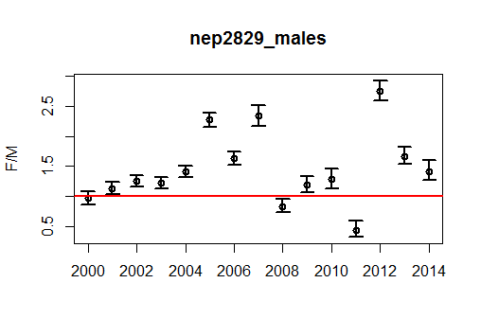
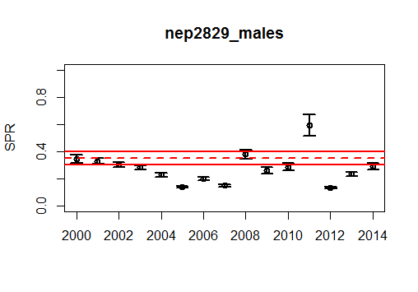
LB-SPR example output
F/M:
SPR/SPR₀:
Analysis suggests that F has been above M and SPR/SPR₀ below 30%
➔ Exploitation above F_{MSY} proxy
Note: ignore 2011 due to problematic fit to length-frequency data

Slide 39
Length-based indicators (LBI)
Data needs:
proportion-at-length in catch (single year)
length at first capture in fishery (estimated from length frequency data)
biological parameters: L_{inf} and length-at-maturity
Assumptions:
recruitment, fishery selection and F constant over time
fishery selection asymptotic
Output:
Range of indicators and their expected values when exploitation is consistent
with conservation of large and immature individuals, optimal yield and MSY

Slide 40
LBI example output
Indicator | Calculation from length-proportions in catch | Reference point | Indicator ratio | Expected value | property
Lc | Length at first catch (length at 50% of mode) | Lmat | Lc/Lmat | >1 | Conservation (immatures)
L25% | 25th percentile of length distribution | Lmat | L25%/Lmat | >1
Lmax5% | Mean length of largest 5% | Linf | Lmax5%/Linf | >0.8 | Conservation (large individuals)
Pmega | Proportion of individuals above Lopt+10% | 0.3–0.4 | Pmega | >0.3
Lmean | Mean length of individuals larger than Lc | Lopt* = [3/(3+M/K)] Linf | Lmean/Lopt | ≈1 (>0.9) | Optimal yield
Lmean | Mean length of individuals larger than Lc | L(F=M) = (1-a) Lc + a Linf, where a=1/(1 + 2 M/K) | Lmean/L(F=M) | ≥1 | MSY
*Lopt is length of maximum cohort biomass with F=0
Lopt and L(F=M) often calculated assuming M/K=1.5

Slide 41
LBI example output
 | Conservation |  |  |  | Optimising yield | MSY
 | Lc/Lmat | L25%/Lmat | Lmax5%/Linf | Pmega | Lmean/Lopt | Lmean/L(F=M)
 | >1 | >1 | >0.8 | >0.3 | ~1 (>0.9) | ≥1
2012 | 1.05 | 1.16 | 0.77 | 0.05 | 0.89 | 0.98
2013 | 1.14 | 1.30 | 0.79 | 0.11 | 0.96 | 1.01
2014 | 1.05 | 1.20 | 0.79 | 0.09 | 0.94 | 1.04
No concerns regarding fishing on immatures
Lack of mega-spawners
➔ Exploitation consistent with F_{MSY} proxy (L(F=M)) and optimal yield

Slide 42
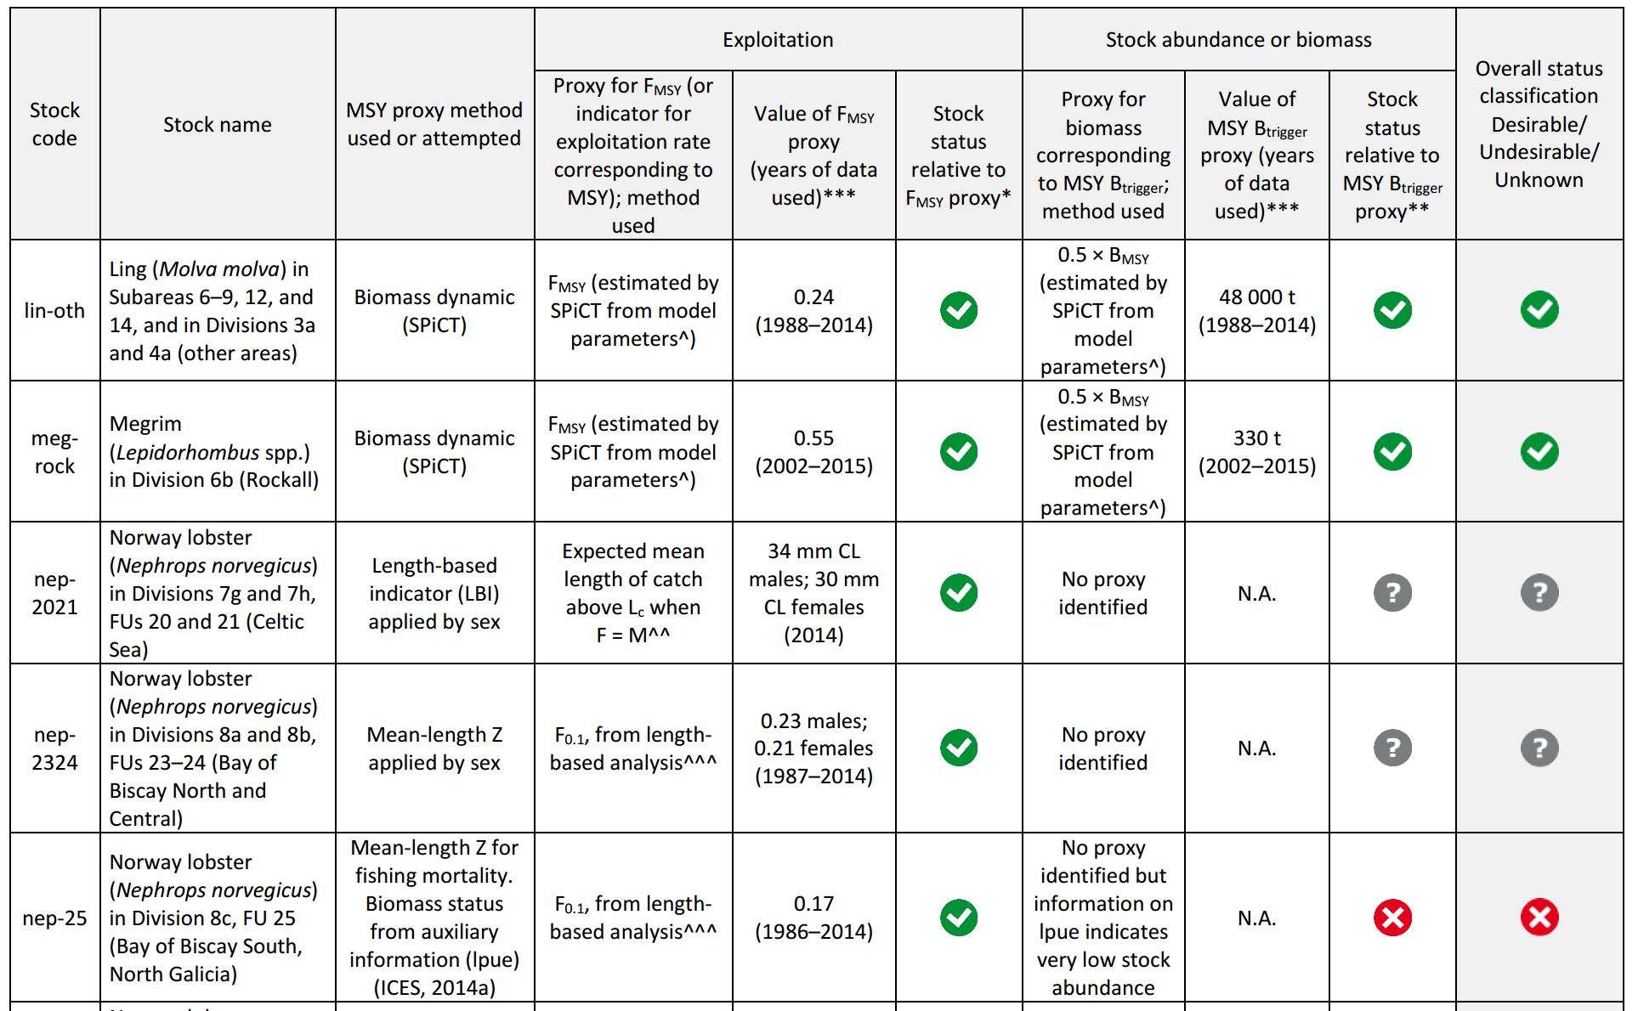

Slide 43
Proxy reference points : catch advice
Advice for Category 3 and 4 stocks continue to use the standard DLS assessment methods
Stock status relative to MSY proxies used to add additional Precautionary Buffer for stocks with undesirable or unknown status
Implementation for other regions: in 2017 with update assessmentss

Slide 44
Future ICES tools
TAF Transparent Assessment Framework, web-based tool for nose-to-tail fish stock assessments
Assessment tools code repository on ICES github sites https://github.com/ices-tools-dev (development area for scientists to use for more general tools) https://github.com/ices-tools-prod (operational area for ICES assessment tools)
Stock Assessment Graphs (SAG)
Stock List Database (SLD) 2016/17
Advice Database 2017
Catch Estimates Over Time Database 2017
Web interface will make accessible all data-limited assessment data, by category or method, stock status, species, stock, with reference points, life-history parameters, etc., over time

Slide 45
What is limiting?
-data or our ability to use data-
The amount/types of available data not considered for a DLS assessment are far greater than the data used.
Most data are simply discarded because they’re not perfect, or they don’t fit with a known method.
An unaffordable luxury.
Challenge:
Find a clever way to use available data in a simple framework that better informs the sustainable use of a stock.
Data & method transparency
Notes:
And lastly, I’d like to share a few thoughts.
As I said, I oversee a lot of stock assessments at ICES, including every DLS. And the amount of data I see thrown overbroad is far greater than the data used.
It is really shocking, and frankly, it is an unaffordable luxury.
We keep complaining that they’re data-limited, but I don’t see it that way.
I think that we’re actually limited by our ability to use the data that we do have. We need to find clever, simple methods that better inform the sustainable use of fishery resources.
To do this, I think we need to increase transparency as well. In this effort, I’m working to bring all ICES stock assessment information on line. We already have this for analytical assessments, but data-limited are next. And for DLS, the raw data will be available for download as well as the information and calculations that were done. These and the history of TACs and catch will be online. So, for (almost all) stocks in the north-east Atlantic the data should be publically accessible.

Slide 46

Future opportunities
WKPROXY
Reference point development
Open to all
More information to come
Become an ICES reviewer
WKLIFE
Annual workshop
Open to all
Develops and test methods
Set the scope and direction for the ICES approach to data-limited stocks

Slide 47

http://www.ices.dk/community/advisory-process/Pages/Latest-Advice.aspx

Slide 48


The Dream
A good model will sort it all out!
Compliments of David Miller, WKLIFE V

Slide 49


The Reality
If you’re lucky it will remove some of the flies…
Compliments of David Miller, WKLIFE V

Slide 50

The Plan
Use ‘good’ data / make informed assumptions
Select an appropriate model
Compliments of David Miller, WKLIFE V

